Slide 1
Inflammation & Chronic Pain Global Pain Association 5 Jun 2021
®
Charles B. Christian, Jr. M.D.
Medical Director
Inside Outside
Wellness Center & Medical Spa
San Antonio, Texas
http://www.insideoutsidespa.com

Slide 2
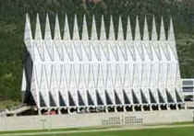
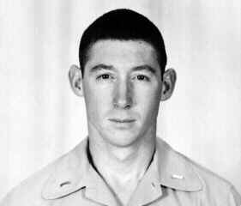
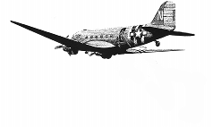
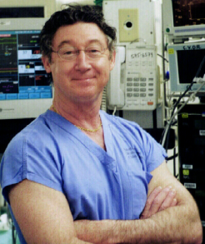
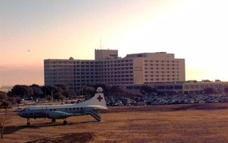
Brief Bio Charles B. Christian, Jr. M.D.
1966 Grad USAF Academy
USAF Combat
Control Team 1966-1969
Medical School 1969-1973
Wilford Hall 73-84 Colonel
Chairman CardioThoracic Surgery
1984 – Current Private Practice
CardioThoracic Surgery-Retired
Medical Director Inside Outside
Methodist Outpatient CardioPulmonary Rehab Supervising Physician
®

Slide 3
Transition from Cardiothoracic Surgery to..
1997 Nutrition and Preventive Medicine Clinic To..
2004 Wellness Center and Medical Spa
®

Slide 4
What People are Really Saying to Us!
®
“I want help with all the Major Health Issues facing me today and I want to look and feel better.”
“I have “NO IDEA” how to do this!”
http://www.insideoutsidespa.com

Slide 5
Our Mission We’re Gonna Help You!
®
Look Better & Younger
Feel Better & Stronger
Live Longer
http://www.insideoutsidespa.com

Slide 6
Our Mission We’re Gonna Help You!
®
“You can never go back and have a new beginning, but.. you can start NOW and have a new ending.”
Carl Bard
Look Better & Younger
Feel Better & Stronger
Live Longer
http://www.insideoutsidespa.com

Slide 7
Hi Intensity, Low Velocity (Hi-Lo) Strength Training® & our Zone/Paleo Nutrition Program
®
Charles B. Christian, Jr. M.D.
Medical Director
Inside Outside
Wellness Center & Medical Spa
San Antonio, Texas
http://www.insideoutsidespa.com

Slide 8
Nutrition & Exercise Two of the 6 Components of an Optimal Health and Aging Program
Injury Prevention
Routine Checkups, Special Screenings
Nutrition
Exercise
Hormone Optimization
Stress and Sleep Management
http://www.insideoutsidespa.com

Slide 9
The Optimal “Health Prescription” for America’s Health & Fitness Crisis
Nutrition
+
Exercise
The Problem
How to help define these two strategies for people
“Frustration”
http://www.insideoutsidespa.com

Slide 10
The Optimal “Health Prescription” for America’s Health & Fitness Crisis
Hi-Lo Strength Training
+
®
Nutrition
Muscles are Starving for Adequate Protein
Muscles are Starving for Adequate Stimulation
BEST RESULTS!
http://www.insideoutsidespa.com

Slide 11
®
What do We all Want?
Health and Wealth
http://www.insideoutsidespa.com

Slide 12
®
Health = Wealth
“Look to your health and if you have it, value it next to a good conscience…” Walden
http://www.insideoutsidespa.com

Slide 13
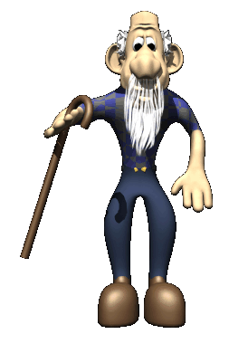
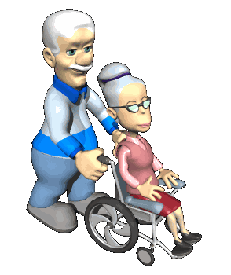
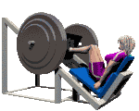
What We Really Fear As We Age
Loss of Mental Capacity
Loss of Functional Capacity
http://www.insideoutsidespa.com

Slide 14
What We Really Fear As We Age
Loss of Mental Capacity
It’s is VERY CLEAR to most
That…
The “Enjoyment” of Life, the Fruits of our Labors and Especially Leisure Activities depends primarily on our Mental and Physical Health!
Loss of Functional Capacity
http://www.insideoutsidespa.com

Slide 15
What We Really Fear As We Age
Loss of Mental Capacity
Anything you can do to
Maintain your health,
Take it to a new level or
Even Regain Your Health
Is a Wise Investment of Time, $$$ and Energy!
Loss of Functional Capacity
http://www.insideoutsidespa.com

Slide 16
®
Our Goal!
Using proven Nutritional, Exercise and Skin Care strategies, we will help you take your health, strength and appearance to a new level!
http://www.insideoutsidespa.com

Slide 17
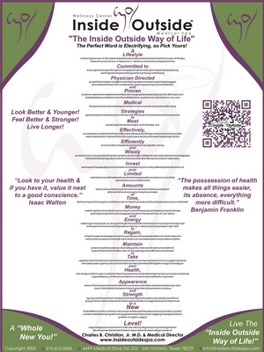
®
In Short!
“The Inside Outside Way of Life! ®”
The Inside Outside Way of Life!

Slide 18
The Inside Outside Hi-Lo Strength Training ® Gym
Hi-Lo Strength Training ® at Inside Outside

Slide 19
Inflammation & Chronic Pain Global Pain Association 5 Jun 2021
®
Charles B. Christian, Jr. M.D.
Medical Director
Inside Outside
Wellness Center & Medical Spa
San Antonio, Texas
http://www.insideoutsidespa.com

Slide 20
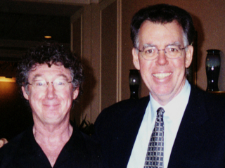
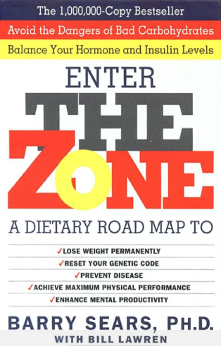
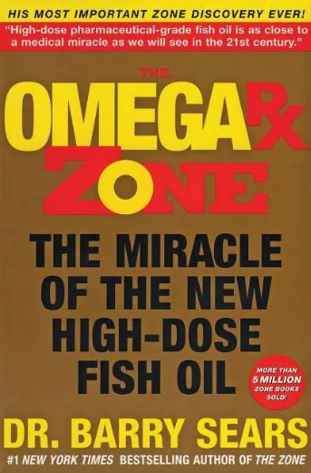
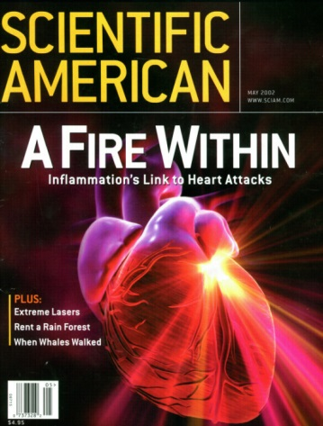
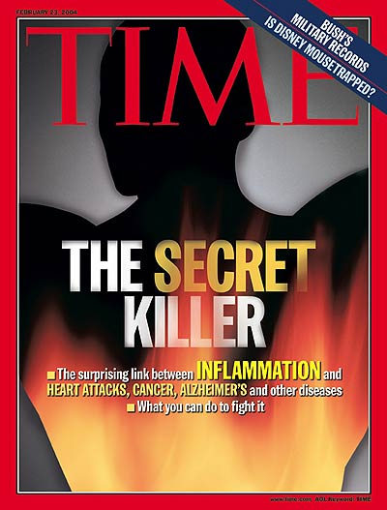
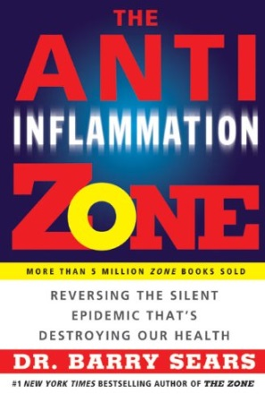
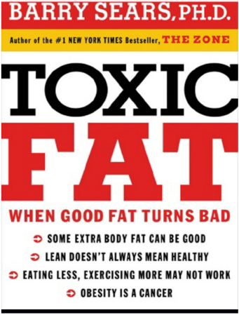
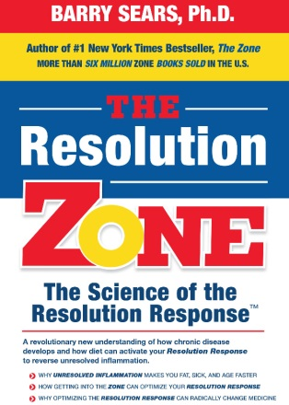
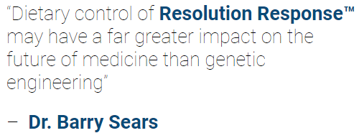
Dr. Barry Sears
1995
1997 Met Dr. Sears
Introduced me to Omega-3s
And his version of the
Mediterranean Diet
“The Zone”
2002
2002, attended
3rd Zone Diet Workshop!
The key to 21st century medicine will be to reduce inflammation and increase blood flow.
2004
2008
2020
“Wellness = Absence of Silent Inflammation”
https://drsears.com/

Slide 21
AARP Bulletin Nov 2019
Wellness = Absence of Silent Inflammation
2004
Everyone’s Favorite
Medical Journal!!
AARP Bulletin Nov 2019 Zimmerman M The Cure for Everything
Zimmerman M Could decreasing Inflammation Be the Cure for Everything, AARP Website 17 Jan 20.

Slide 22
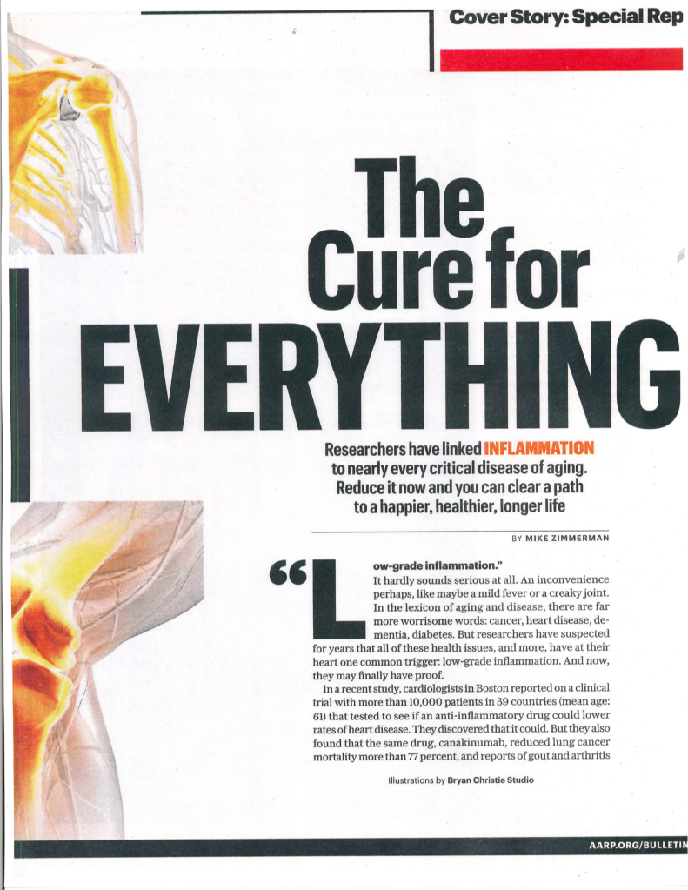
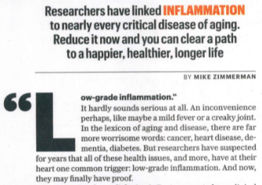
AARP Bulletin Nov 2019
Wellness = Absence of Silent Inflammation
2004
The “CANTOS” Study
AARP Bulletin Nov 2019 Zimmerman M The Cure for Everything
Zimmerman M Could decreasing Inflammation Be the Cure for Everything, AARP Website 17 Jan 20.

Slide 23
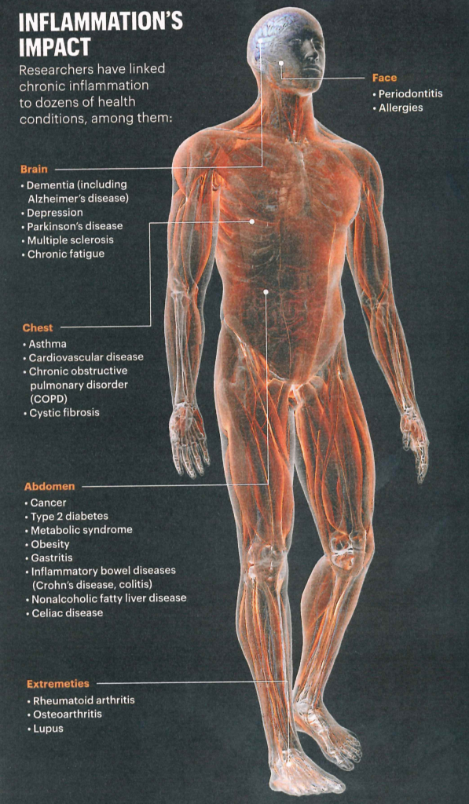
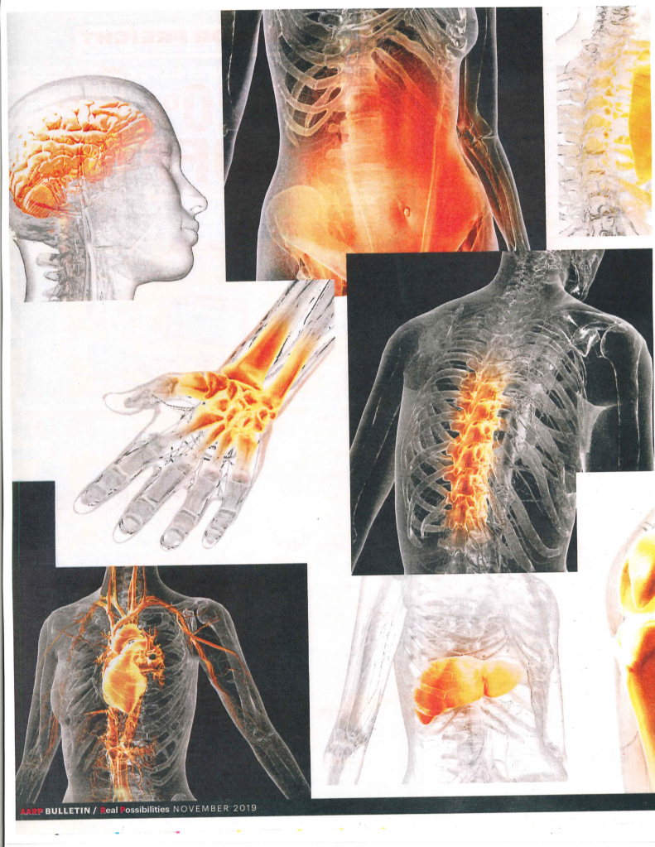
AARP Bulletin Nov 2019
Wellness = Absence of Silent Inflammation
AARP Bulletin Nov 2019 Zimmerman M The Cure for Everything
Zimmerman M Could decreasing Inflammation Be the Cure for Everything, AARP Website 17 Jan 20.

Slide 24
AARP Bulletin Nov 2019
Wellness = Absence of Silent Inflammation
Our Evolved Immune & Inflammatory Response is so Robust it can Liquefy or Fibrose (Scar) any tissue or organ!
“You need some inflammation to survive but you have to reduce, resolve, and repair the damage caused by the initial inflammation to remain well and thus significantly delay the development of chronic disease. Dr. Sears
AARP Bulletin Nov 2019 Zimmerman M The Cure for Everything
Zimmerman M Could decreasing Inflammation Be the Cure for Everything? AARP Website 17 Jan 20.

Slide 25
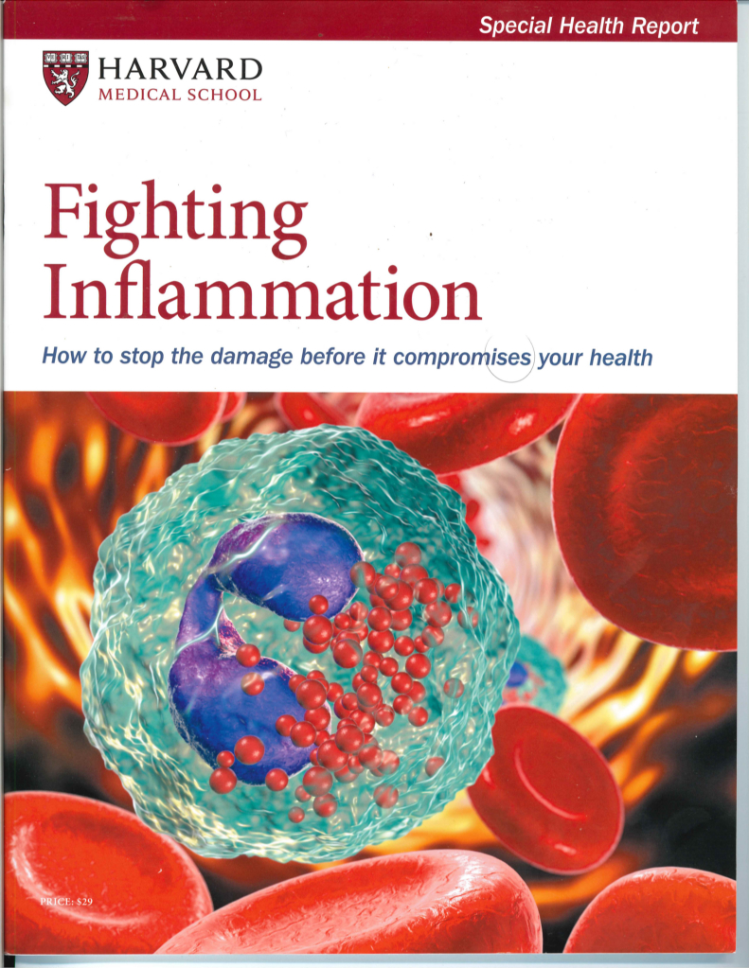
Dr. Charles Serhan – Resolution of Inflammation with Specialized Pro-Resolving Lipid Mediators (SPM) formed from Omega-3 Fat
“To identify novel bioactive mediators, pathways, and cellular targets critical in activating resolution of inflammation and their relation to human disease.”
Serhan Lab Brigham & Women’s Hospital Harvard Medical School
Serhan CN Lipid Mediators put an end to Inflammation Monograph
Shaw J Raw and Red-Hot: Could Inflammation be the cause of myriad Chronic Conditions Harvard Magazine May-Jun 2019
Inflammation Resolution & SPMs: Video Animation Metagenics Institute

Slide 26
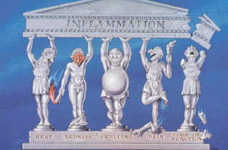
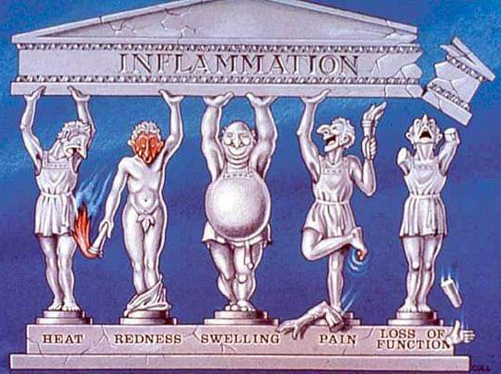
Aulus Cornelius Celsus 45BC-50AD
Cardinal Signs of Acute Inflammation
Added by
Galen
Calor Rubor Tumor Dolor Functio Laesa

Slide 27
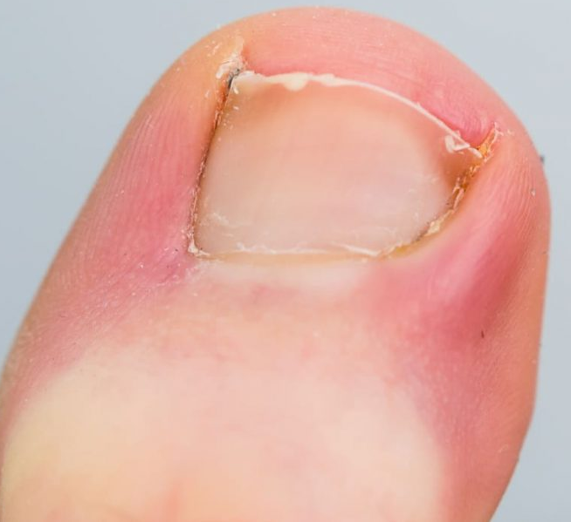
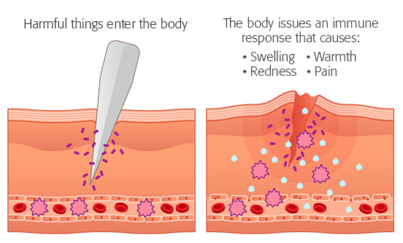
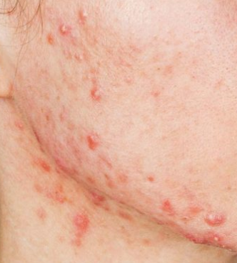
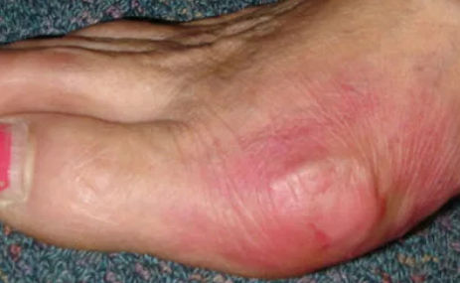
We all recognize Acute Inflammation

Slide 28
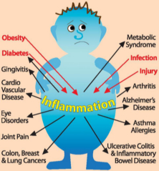
Many Sources/Causes of Ongoing Chronic Low Grade Inflammation
Wellness = Absence of Silent Inflammation
Viruses – Acute and Chronic Flu, colds, CMV, Hepatitis A, B, C. Coronovirus, EBV.
Chronic Infection, Bacteria, Tuberculosis, Parasites, Lyme Disease, STDs, Gum Disease
Injuries, overtraining, musculoskeletal Imbalance or deformities
Pollution, air & water quality, environmental allergies, chemicals, UV Light, ?EMF
Diet Choices, Obesity, Visceral Fat, Stress, Smoking, Alcohol, Poor Sleep Quality.
On Going Free Radical Production with Oxidative Stress
Auto Immune Disease: Rheumatoid Arthritis, Crohn’s, Ulcerative Colitis and Cancers contain lots of neutrophils which have a half life of 4hrs, They die and create a reaction that attracts more PMN.
Metabolic Disorders: Diabetes, Gout
Surgical Injury and delayed healing
Defective Autophagy: As aging cells die off they create “InflammAging”
Loss of Respiratory Barrier Function: Cystic Fibrosis and COPD
Loss of Skin Barrier Function
Loss of Gut Barrier Function “Leaky Gut” due to Inflammatory Diet.
Cell Membrane Barrier Structural Abnormalities
Pahwa R et al Chronic Inflammation. STAT Pearls 20 Nov 20
Francheschi et al InflammAging & ‘Garb-aging”. Cell Press Mar 2017

Slide 29
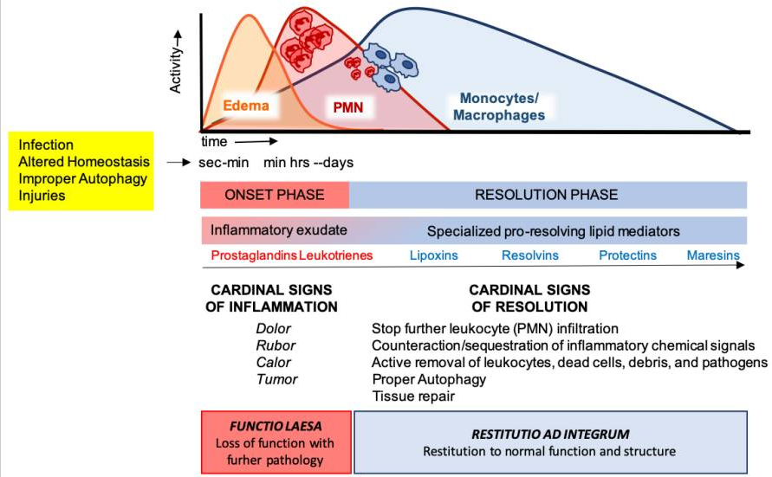
Goal–Resolution of Acute Inflammation without Tissue damage or Chronic Pain Enter Specialized Pro-Resolving Lipid Mediators (SPM) Created from Omega-3 Fat
Omega-3s
Serhan CN Novel Pro-Resolving Lipid Mediators are Leads for Resolution Physiology. Nature & PMC 2011

Slide 30
How Can I tell If I have Silent Inflammation?
White Blood Cell Count
hs-C-Reactive Protein (High Sensitivity CRP) This was lowered in the “CANTOS Study”
Erythrocyte Sedimentation Rate ESR
Ferritin
Inflammatory Cytokines: IL-6, IL-1b, TNF-a, IL-18, NF-Kb (Measured Often In COVID)
Omega-3 Index
Omega-6/Omega-3 Ratio and AA/EPA Ratio
“Cytokine Storm”
Common Chronic Conditions Associated with Elevated Markers of Inflammation
Obesity, Visceral Fat, Diabetes, Auto-Immune Disease, Stress,
Poor Sleep (Sleep Apnea), Emphysema (COPD), Migraine, Neuropathy
Most Chronic Pain will have Elevated Markers!
Vanderwall AG et al Cytokines in Pain: Harnessing Endogenous Anti-inflammatory Signaling for Improved Pain Management. Front Immun 23 Dec 2019
Pan JI et al Association of elevated inflammatory markers and severe COVID 19 A Meta Analysis Medicine. (Baltimore) 2020 Nov 20

Slide 31
Problem – Non Resolving Inflammation
Loss of function – Fibrosis of Lung, Liver (Cirrhosis)
Loss of Structure – Acne Scaring
“The problem with inflammation is not how often it starts, but how often it fails to subside. Perhaps no single phenomenon contributes more to the medical burden in industrialized societies than non-resolving inflammation.”
This Contributes to Chronic Pain Syndromes & Flare Ups!
Nathan C et al Non-Resolving Inflammation. Cell 140 6, Mar 19 2010

Slide 32
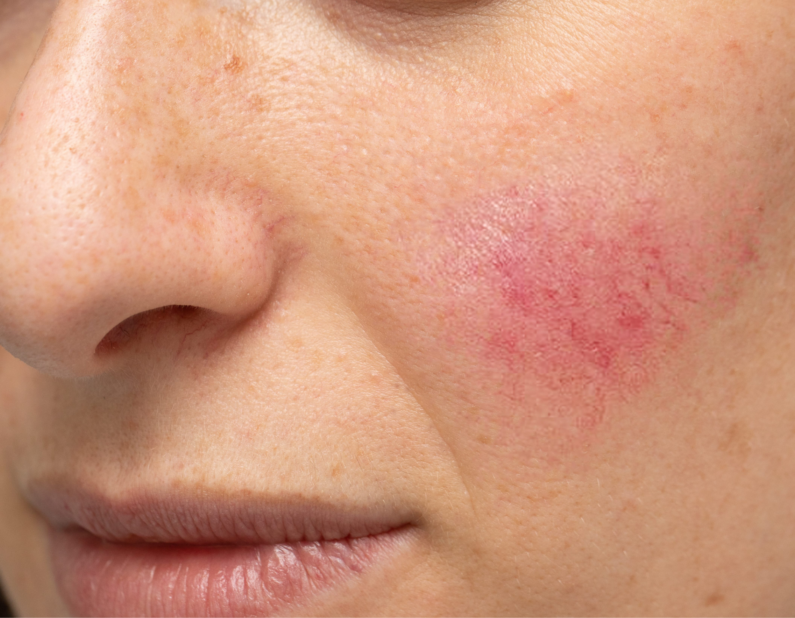
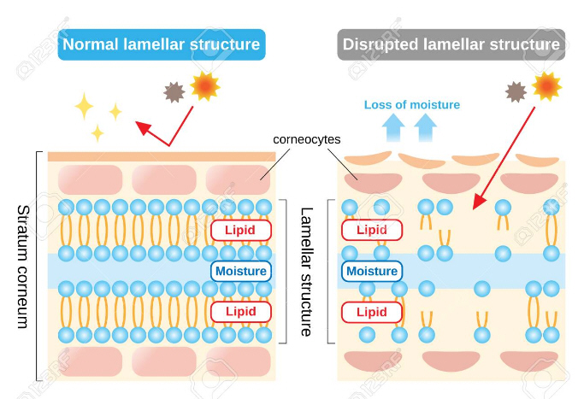
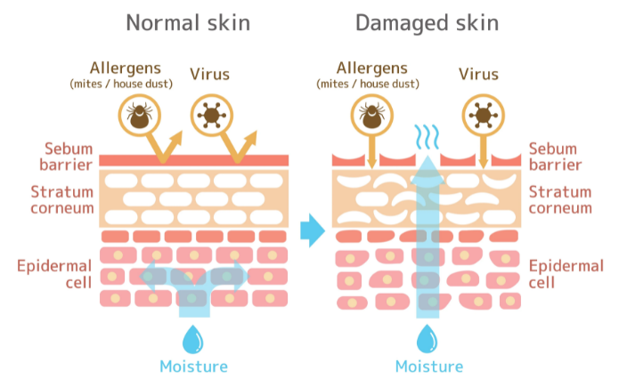
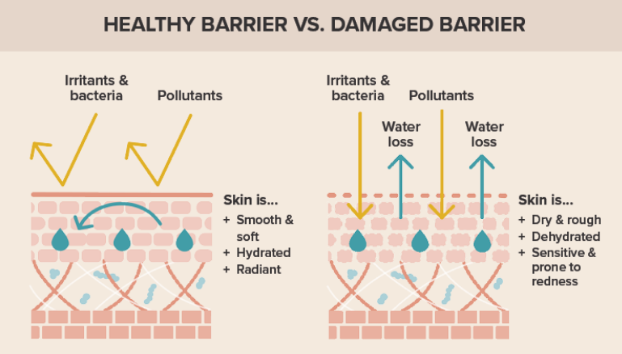
Sources of Inflammation Loss of Skin Barrier Function
Skin Barrier –Red, Irritated, Sensitive, Dry Skin
Loss of Ceramides, fatty acids, cholesterol, squalene
More susceptible to pollutants, chemicals, allergens, bacteria
Don’t use harsh soaps on Body and use Ceramide Moisturizer after showering.
Kim BE et al Significance of Skin Barrier Dysfunction in Atopic Dermatitis. Allergy Asthma Imm Res May 2018

Slide 33
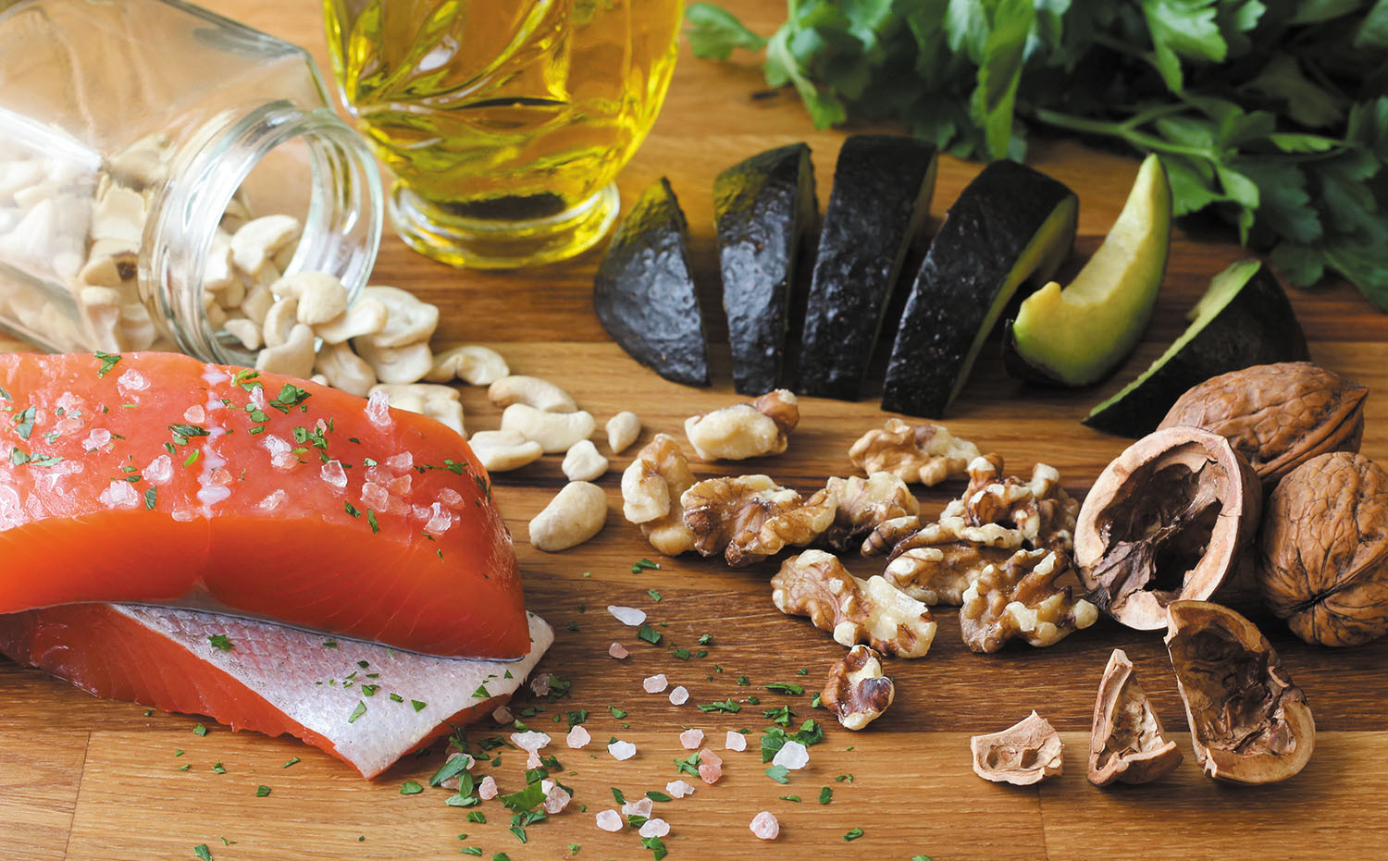
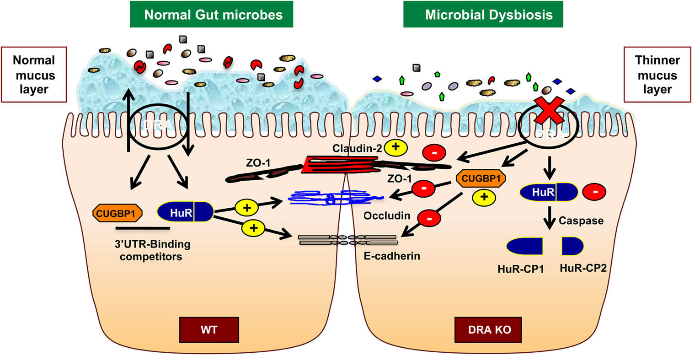
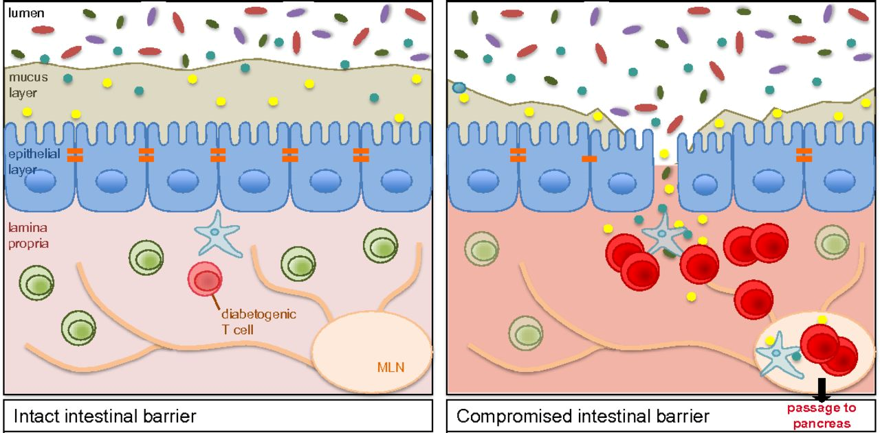
Sources of Inflammation Loss of Gut Barrier Function
Gut Barrier – Diarrhea, Constipation, Pain, Bloating
“Leaky Gut” due to Loss of protective mucus layer, good/diverse bacteria & disruption of tight Junctions allow endotoxins and food particles to enter our blood and this causes inflammation.
Anti-Inflammatory Diet, Fiber, Probiotics, Fermented Foods, Polyphenols, Prebiotics, Less Alcohol
Wells JM et al Homeostasis of the gut barrier and potential biomarkers. Am J Physiol Gastrointest Liver Phys 2017 Mar 1; 312(3)

Slide 34
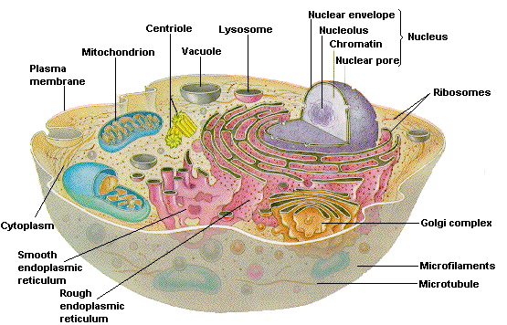
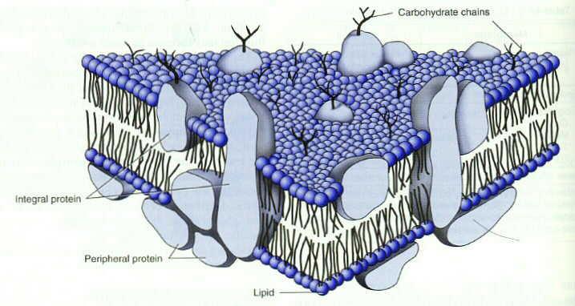
Cell Membrane – Another Critical Barrier to Keep Healthy
Membrane/Structural Fat: 60-70% of a Cell Membrane is composed of Fat. Very important fat..
Membrane Fat “Phospholipids’
Membrane Proteins

Slide 35
Workshop
I attended
In 1997
Take Away: If You “Fix” or “Restructure” Cell Membranes, a lot of things get better!!

Slide 36
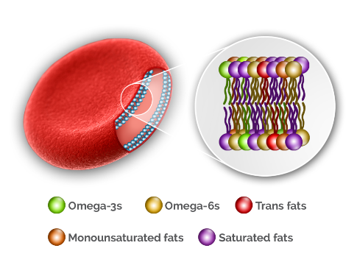
Cell Membrane – Another Critical Barrier to Keep Healthy
Membrane/Structural Fat: 60-70% of a Cell Membrane is composed of Fat. Very important fat..
Some of the fat we eat ends up in our cell membranes.
We Need 8-12%
Of that Fat to be
Omega-3s
EPA + DHA or
Omega-3 Index
Essential Fatty Acids
EPA & DHA
Vegetable Oils
Olive Oil, Avocado, Almonds
Much of the Fat we Eat! Eggs, steak, dairy
Omega Quant Website for Omega-3 Index Testing

Slide 37
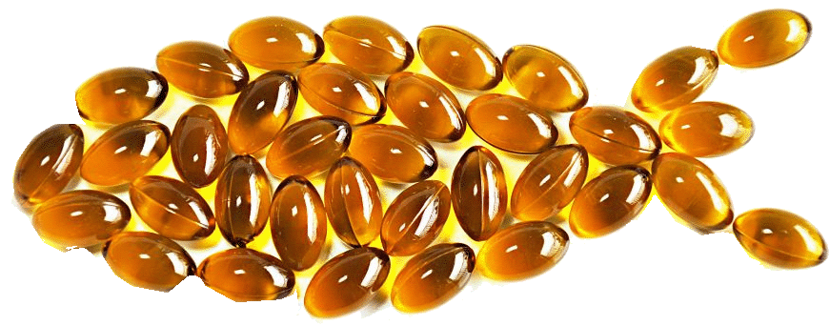
How we Use Omega-6 Vs Omega-3 Metabolism Simplified
Too Much Omega-6
Vegetable Oils
Linoleic Acid
Too Little Omega-3
Alpha Linoleic Acid (Flax Oil)
Eicasapentanoic Acid -EPA
Arachidonic Acid -AA
Fish
Oil
Docosahexanoic Acid- DHA
Prostaglandins PGF2
Leukotrienes LTB4
Specialized Pro-Resolving Mediators
Resolvins, Protectins, Marisens
Initiate Inflammation
NF-kB, TNF-a
IL-1b, IL-6
We can Measure Total EPA+ DHA and AA/EPA Ratio
Resolution
Inflammation, heals,
restores structure and function
Ko GD et al Omega-3 Fatty Acids and Neuropathic Pain Practical Pain Management 2008

Slide 38
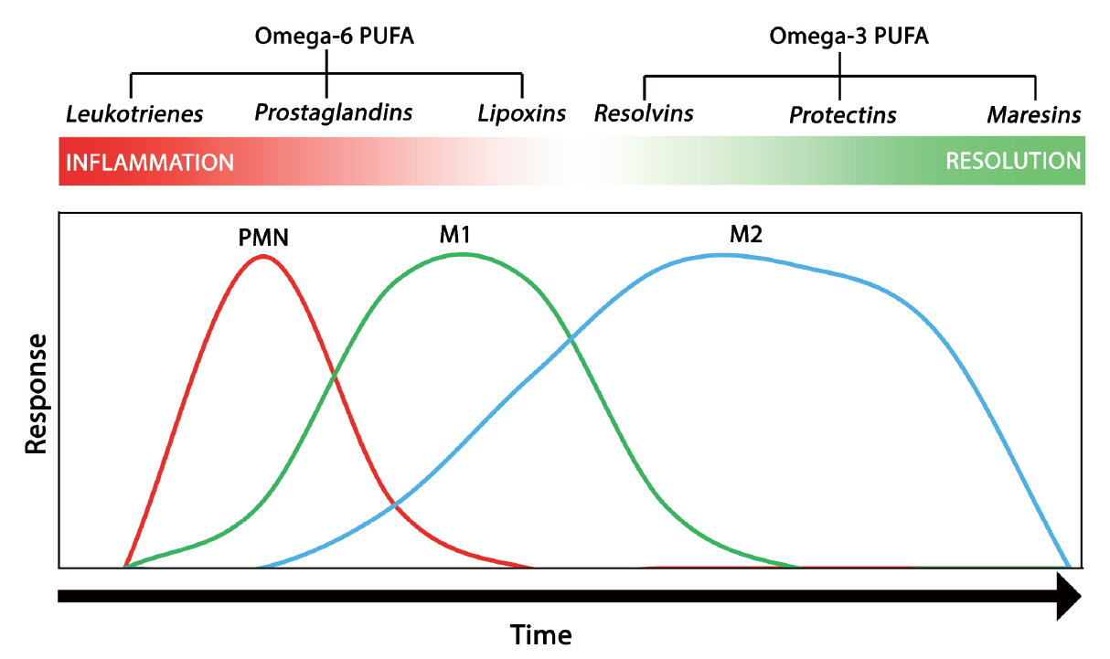
Deficient Omega-3 for Resolution?
INITIATION
RESOLUTION
Most of Us Don’t Have Enough Omega 3 in Cell Membranes to Enable Resolution Phase to Occur!
Markworth JF Emerging roles of pro-resolving Mediators in Immunological and adaptive responses to exercise Ex Imm Rev 2016

Slide 39
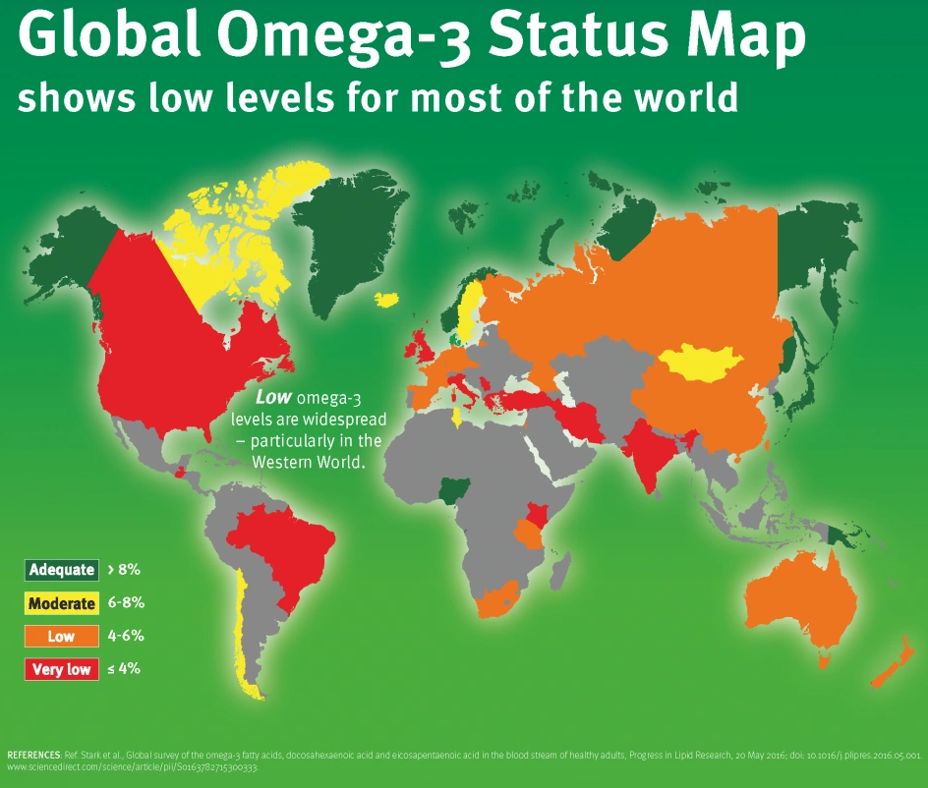
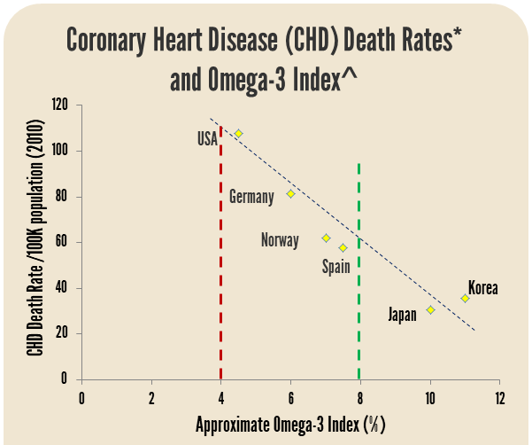
Omega-3 Index Status Worldwide
USA <4%
8-12% Optimal
Stark KD et al Global Survey of the omega-3 fatty acids, DHA and EPA in the blood stream of healthy adults. Prog Lipid Res Jul 2016 Vol 63

Slide 40
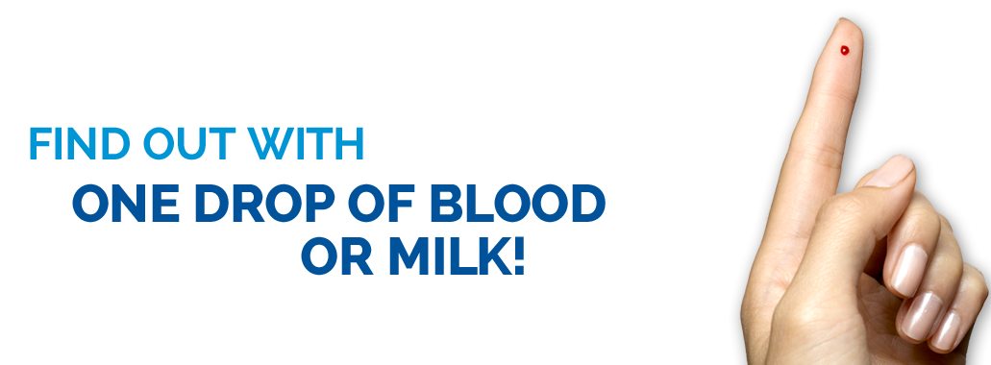
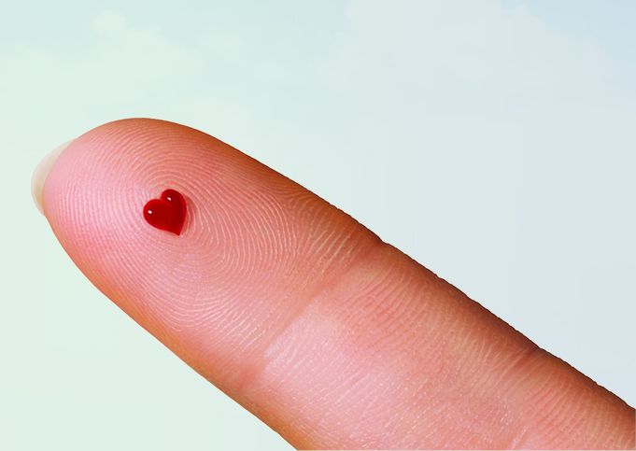
Omega-3 Index Testing
Simple At Home Testing
$100
Many Doctors are doing this testing as part of your yearly Lab Work!
Omega Quant Omega-3 Index Testing

Slide 41
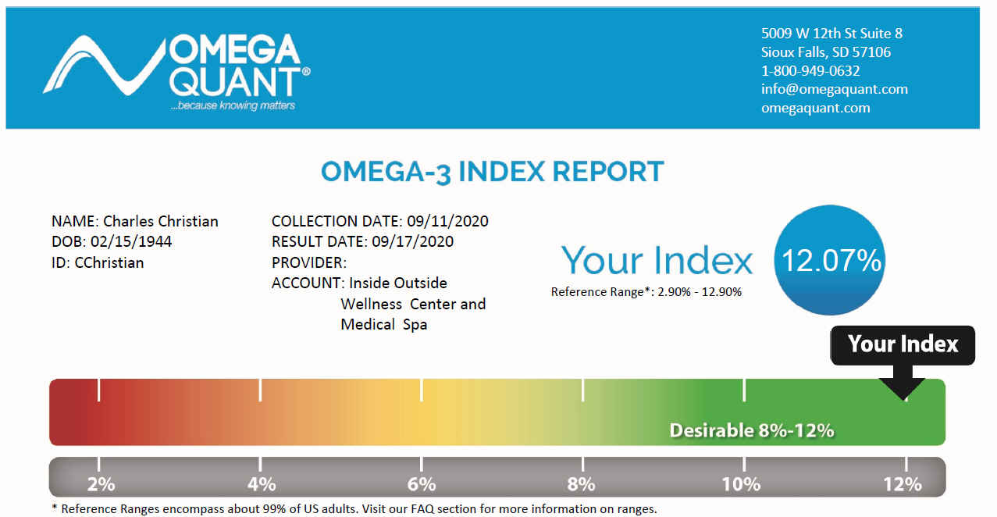
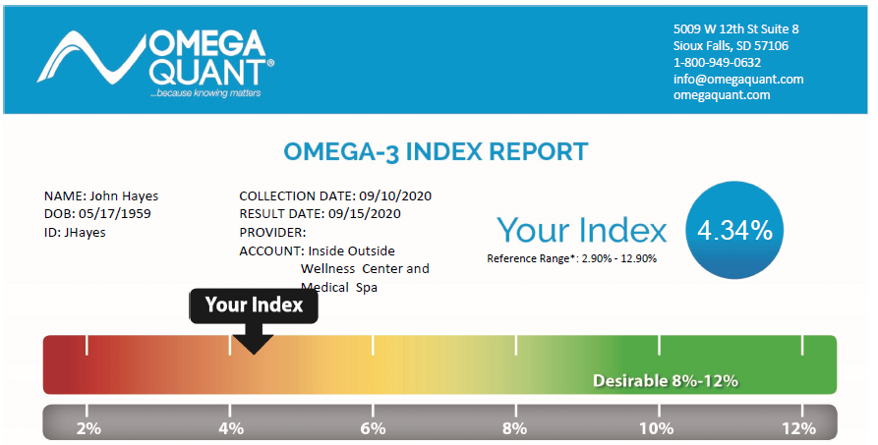
Omega-3 Index Results Typical Client
%EPA+%DHA
Red Blood Cell
Membrane
8-12% Optimal
3-4
Months
2.5-3gm
EPA+DHA
Diet or Supplements
Dr. Christian Omega 3 Index

Slide 42
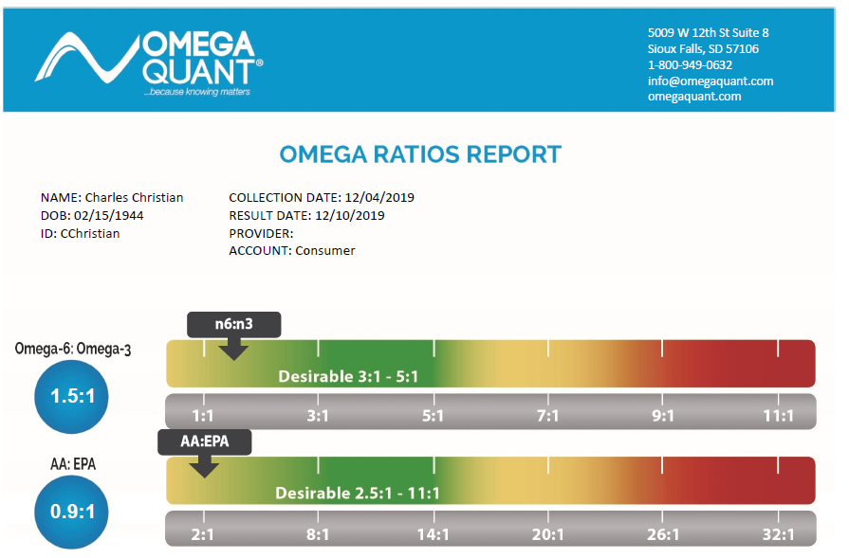
Omega Ratio Results Typical Client
Lot’s of Inflammation!
3-4
Months
2.5-3gm
EPA+DHA
Diet or Supplements
Dr. Christian’s Ratios
Much Less Inflammation

Slide 43
My Grandmother at the Dinner Table
Dr. Christian – Growing Up In Tuscaloosa
Charlie!
Eat that Meat!
Charlie!
Eat those Vegetables
Charlie! Gag down this Cod Liver Oil! You are one Puny Kid!!
Grandmother Practiced “Precision Nutrition”

Slide 44
“When babies don’t swallow their daily dose of cod liver oil, their mothers are usually to blame …”
“The biggest mistake we have made in the Last 30 years is when we stopped giving our kids a tablespoon of Cod Liver Oil every day.”
Barry Sears Phd.

Slide 45
The End!! Remember!!
In Life's great experiment, You Are Your Own Guinea Pig
Take care of the Pig!!!!
®

Slide 46
References
Dr. Barry Sears Website
AARP Bulletin Nov 2019 “The Cure for Everything” Magazine Article .pdf
Zimmerman M Could decreasing Inflammation Be the Cure for Everything,
AARP Website 17 Jan 20.
4. Serhan Lab Brigham & Women’s Hospital Harvard Medical School
5. Serhan CN Lipid Mediators put an end to Inflammation. Monograph
6. Pahwa R et al Chronic Inflammation. STAT Pearls 20 Nov 20
7. Serhan CN Novel Pro-Resolving Lipid Mediators are Leads for Resolution
Physiology. Nature & PMC 2011
8. Nathan C et al Non-Resolving Inflammation. Cell 140 6, Mar 19 2010
9. Shaw J Raw and Red-Hot: Could Inflammation be the cause of myriad
Chronic Conditions? Harvard Magazine May-Jun 2019
10. Inflammation Resolution & SPMs: Video Animation Metagenics Institute
11. 10. Pan JI et al Association of elevated inflammatory markers and severe
COVID 19 A Meta Analysis. Medicine (Baltimore) 2020 Nov 20
12. Vanderwall AG et al Cytokines in Pain: Harnessing Endogenous
Anti-inflammatory Signaling for Improved Pain Management
Front Immun 23 Dec 2019

Slide 47
References
13. Kim BE et al Significance of Skin Barrier Dysfunction in Atopic Dermatitis. Allergy Asthma Imm Res May 2018
14. Wells JM et al Homeostasis of the gut barrier and potential biomarkers. Am J Physiol Gastrointest Live Phys 2017 Mar 1; 312(3)
15. Omega Quant Website for Omega-3 Index Testing
16. Ko GD et al Omega-3 Fatty Acids and Neuropathic Pain. Practical Pain Management 2008
17. Markworth JF Emerging roles of pro-resolving Mediators in Immunological and adaptive responses to exercise. Ex Imm Rev 2016
18. Stark KD et al Global Survey of the omega-3 fatty acids, DHA and EPA in the blood stream of health adults. Prog Lipid Res Jul 2016 Vol 63
19. Al-Shaer et al Polyunsaturated fatty acids, specialized pro-resolving
Mediators, and targeting inflammation resolution in the age of precision nutrition. Molecular and Cell Bio Lipids Mar 2021.
20. Francheschi et al Inflammaging & ‘Garb-aging” Cell Press Mar 2017
21. International Fish Oil Standards Program
22. Global Organization for EPA and DHA Omega 3.

Slide 48
International Fish Oil Standards Program

Slide 49
Global Organization for EPA and DHA Omega 3.
OmegaRx2 Fish Oil Purity Report Example

